Slide 1



Measuring the Photometric Z with the LSST
Gina Moraila
University of Arizona
April 21, 2012

Slide 2
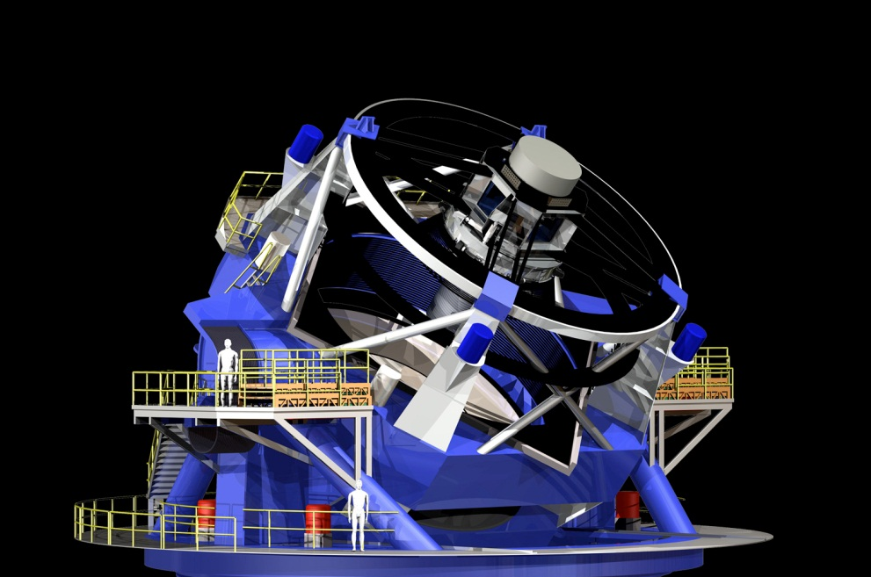
Large Synoptic Survey Telescope
Large – 8.4 primary mirror and 3.2 GigaPixel CCD camera has a field of view of ~ 50 moons
Synoptic – Will produce a view of the entire southern sky twice a week for 10 years
Survey – Will identify 10 billion galaxies and a similar number of stars
Telescope – will be located
at Cerro Pachón, Chile and
see first light in 2018
http://www.lsst.org/lsst/gallery/telescope

Slide 3

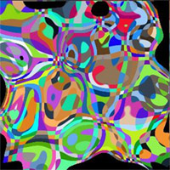
Exploring Dark Energy
75% - Dark energy is thought to be causing the accelerating! expansion of the universe
20% - Dark matter is thought to be causing the difference between luminous mass and gravitational mass in galaxies
5% - Stars
We will use weak gravitational lensing to infer the distribution of dark matter as a function of distance (redshift z) which will tell us about the effects of dark energy
Weak lensing
(exaggerated)
http://snap.lbl.gov/science/how.php

Slide 4
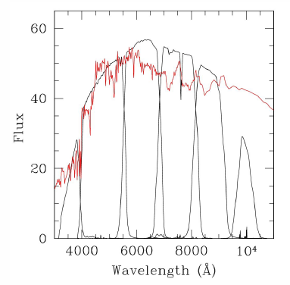
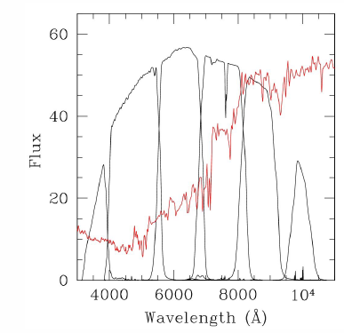
Photometric Redshift
In order to determine the redshift z (distance) of galaxies one measures the light from them using six different filters
This is needed to interpret the weak lensing signal
z=0.0
z=0.75
LSST Ideal Filters
100.0
80.0
60.0
Transmission
u
g
r
i
z
Y
40.0
20.0
0.0
300
400
500
600
700
800
900
1000
1100
1200
Wavelength (nm)
http://wwwgroup.slac.stanford.edu/kipac/OSU_PDFs_for_lsst_tutorial/marshall_lsst_tutorial.pdf

Slide 5
Bayesian Photo-z Estimation
We use a Bayesian method* to determine the most probable redshift z from a given color distribution
P(C|z) is the probability (likelihood) of observing color C given redshift z
P(z|m) is the prior probability of observing redshift z given magnitude m
P(C) is a normalization constant
* N. Benitez, ApJ 536 (2000) 571

Slide 6
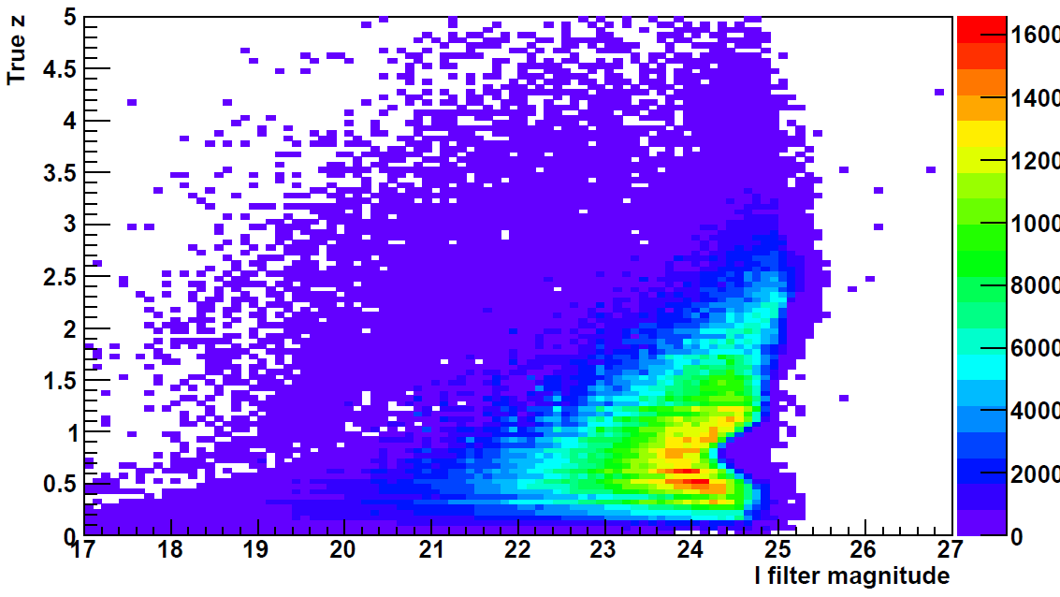
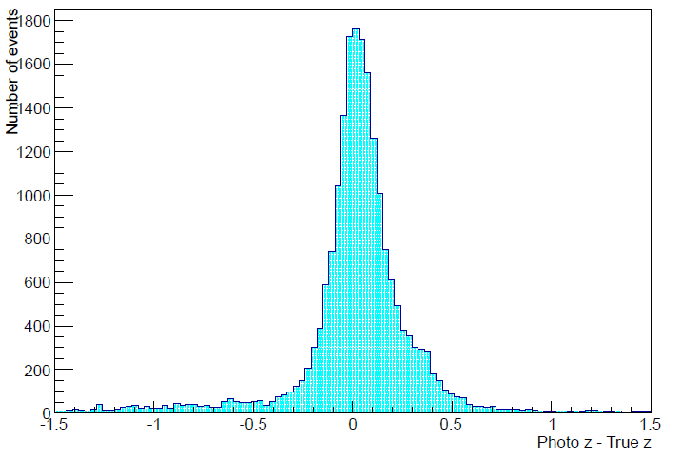
Results
By analyzing the redshift z distribution as a function of the magnitude m in the I filter, we developed a new prior P(z|m)
σ=0.12
Redshift z as a function of
magnitude m
Photo z – True z with new prior

Slide 7
Conclusions
We implemented a Bayesian method for determining the photometric z for simulated LSST data
We developed a prior P(z|m) that significantly improved performance compared to a flat prior
Our results are

Slide 8

With special thanks to Alex Abate (technical expert) and Kenneth Johns (mentor) The University of Arizona Physics Department Arizona NASA Space Grant Consortium

Slide 9
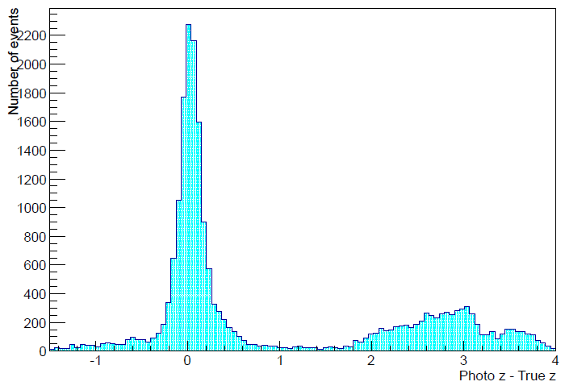
Results
By analyzing the redshift z distribution as a function of the magnitude m in the I filter, we developed a new prior P(z|m)
σ=0.12
Photo z – True z with flat prior
Photo z – True z with new prior

